Slide 1


ACE HACK 2.0 HACKHTON
Team Name : Panthers
Team Members : kanchan
Jayendra Sharma
College Name: Poornima Institute of Engineering and Technology

Slide 2
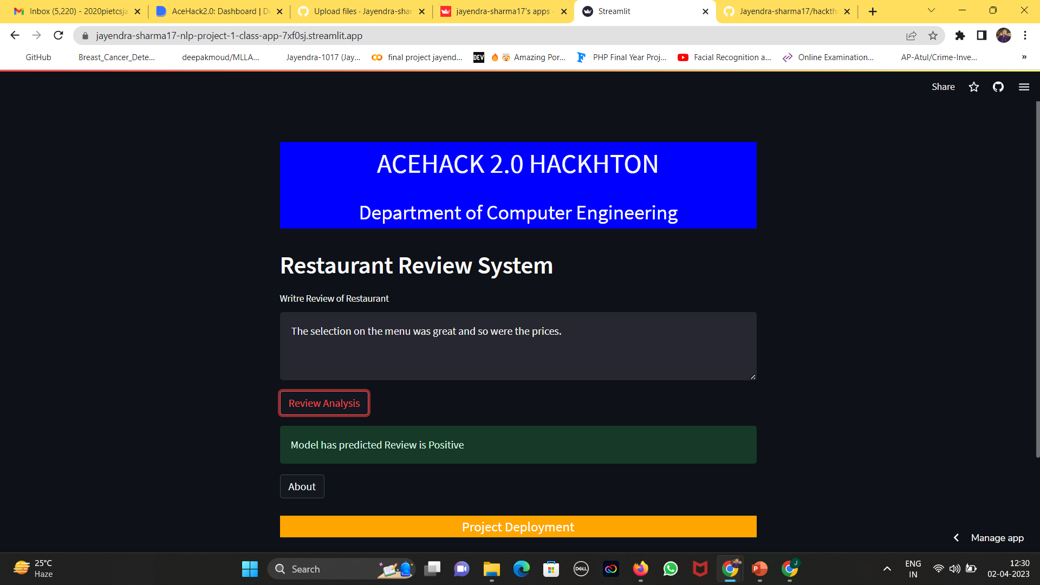
PROJECT NAME
Customer feedback management system

Slide 3
Project objective
Create a natural language processing (NLP) system that can analyze customer feedback.

Slide 4
Explain your solution in brief
We have made a model that is used for checking the reviews of customer.
By doing this feedback system the hotel/restaurant etc can improve their quality of food or anything.
For this we have made a machine learning model of natural language processing.
We have take our corpus from Kaggle.
Some important steps are require for natural language processing.

Slide 5
Explain working principle
Taking corpus from Kaggle.
Used natural language processing.
Then we to convert the corpus:-
cleaning Text and removing number and punctuation marks.
converting text into lower case.
Removing stop words like 'this, the’.
converting stemming words.
Calculating Accuracy.
Then deploy our model on streamlit.

Slide 6
Explain the tech-stack of your solution.
Html.
CSS.
Python.
Python libraries.
5. Machine learning.
For Deployment:-
Streamlit.

Slide 7
Project outcome
After making of this project restaurant can take the reviews and improve the quality of their food and services

Slide 8
THANK YOU
ANY QUERY ?

